Slide 1

SSR 23-24/13
AMRITA BLOCKCHAIN CLUB

Slide 2

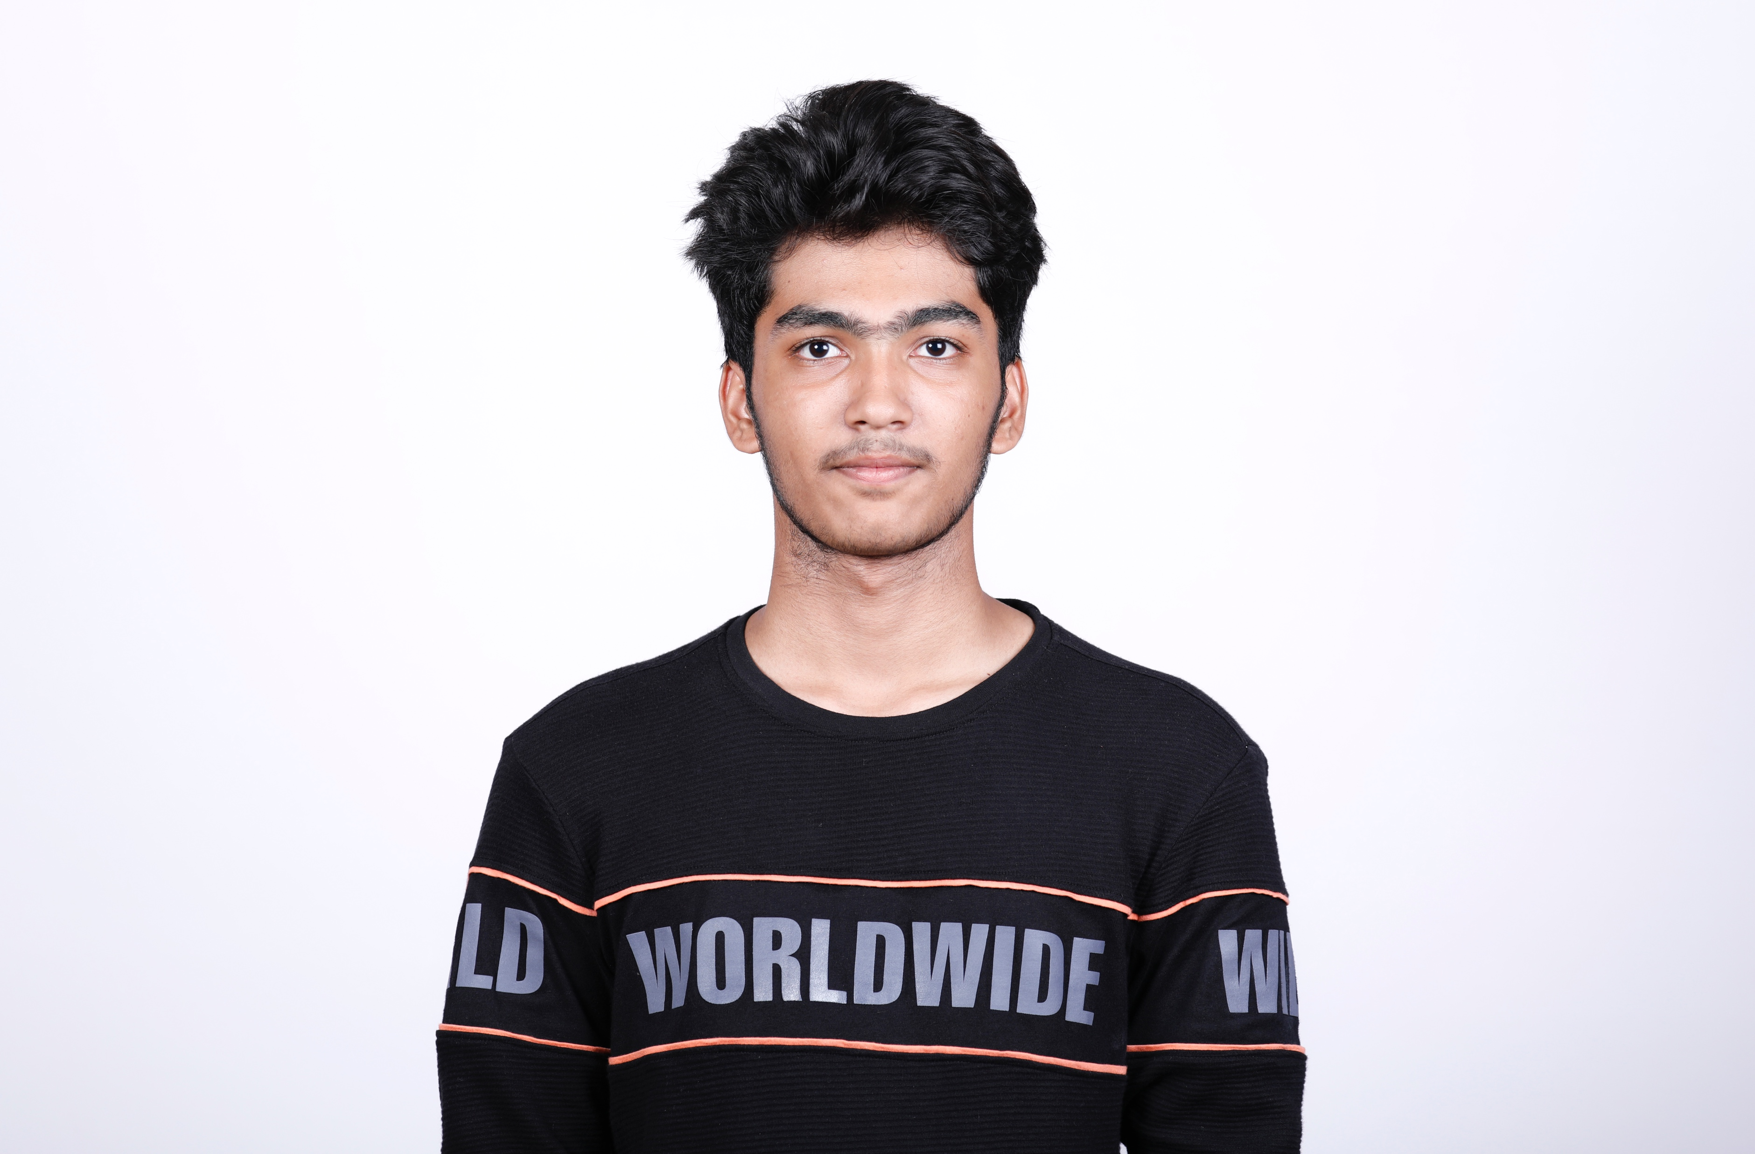
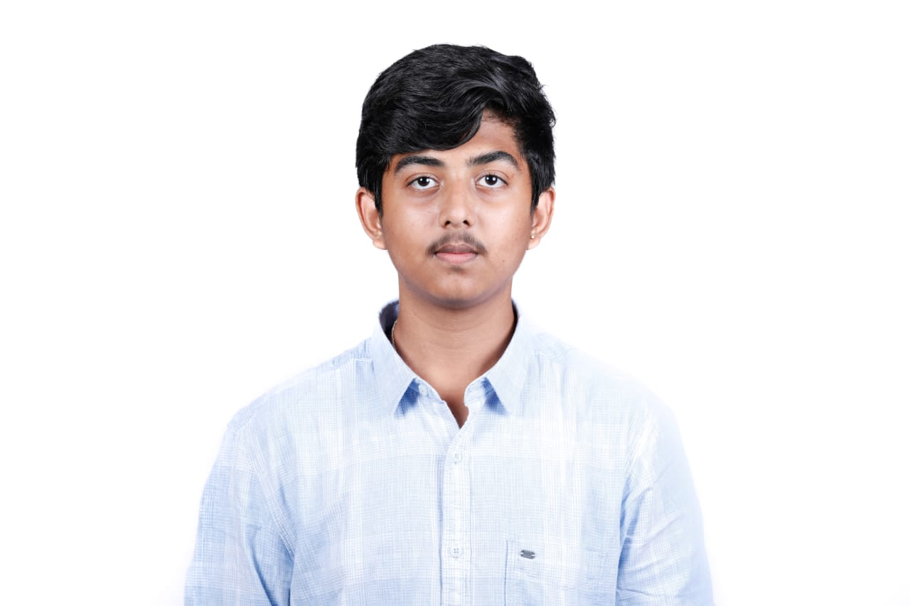
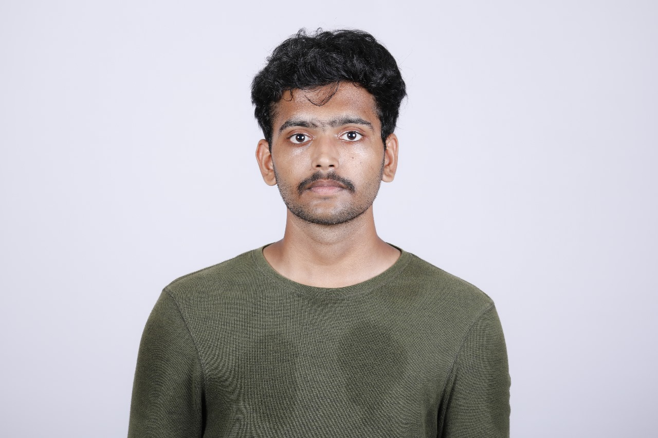
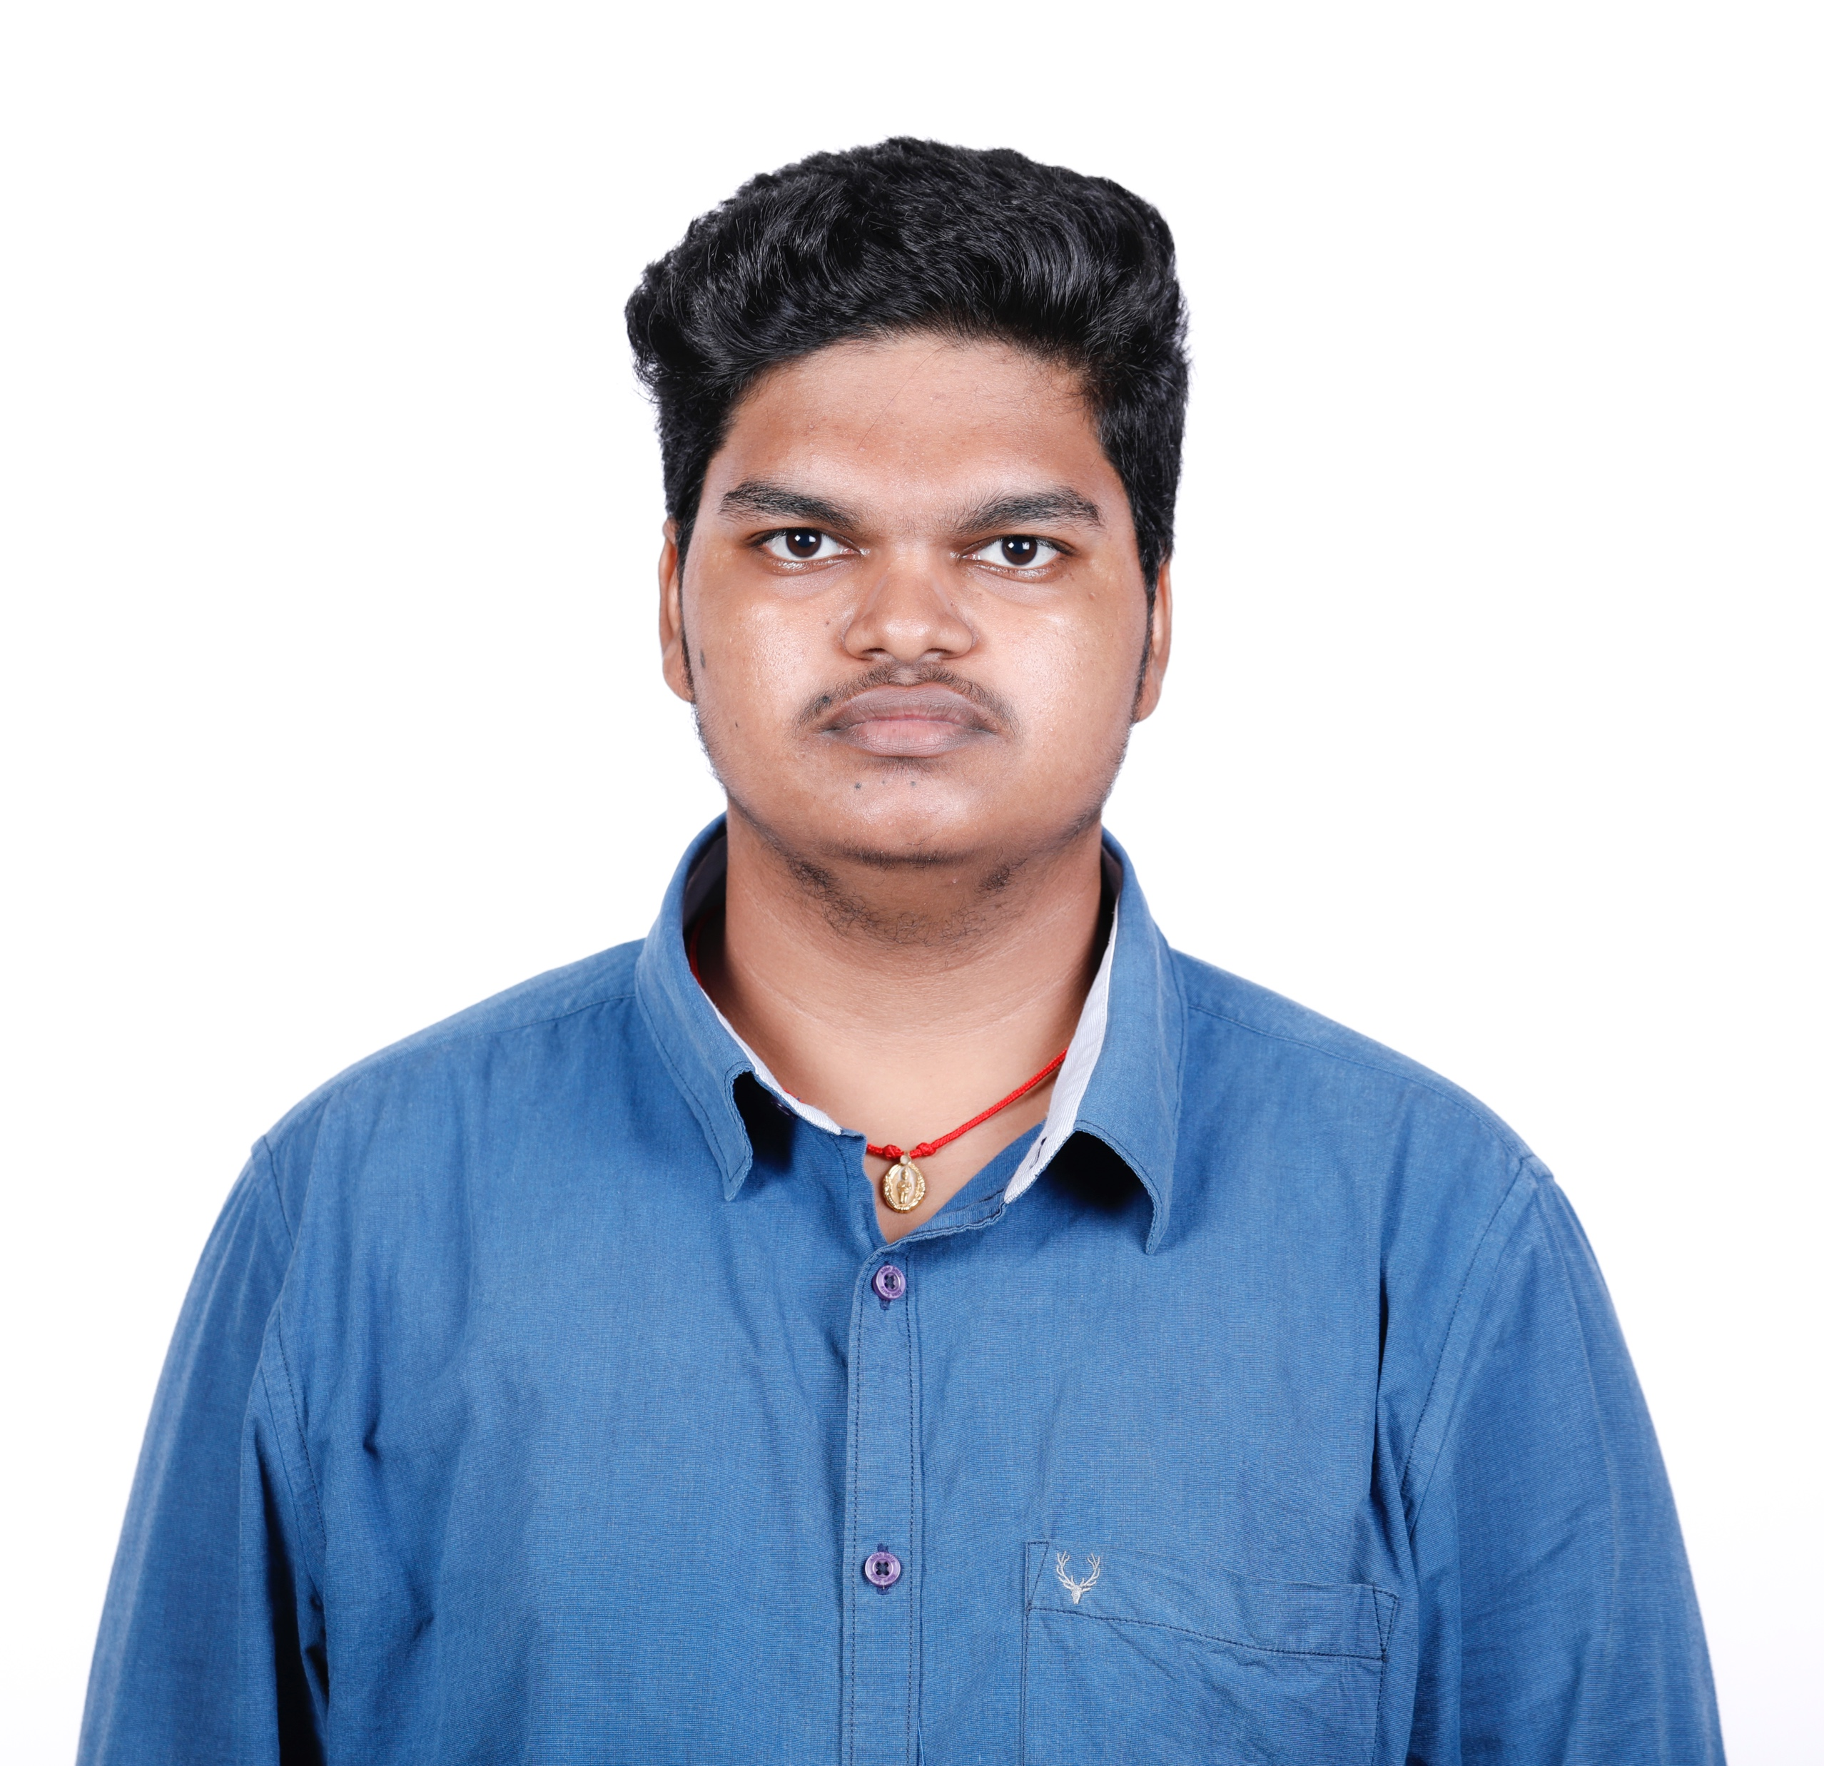
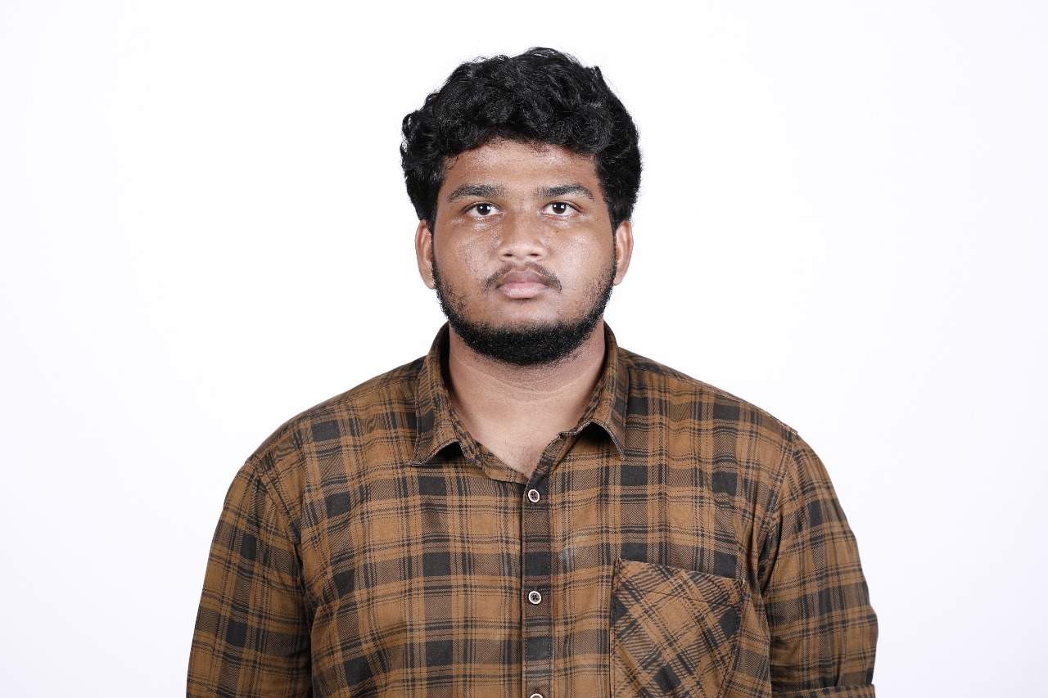
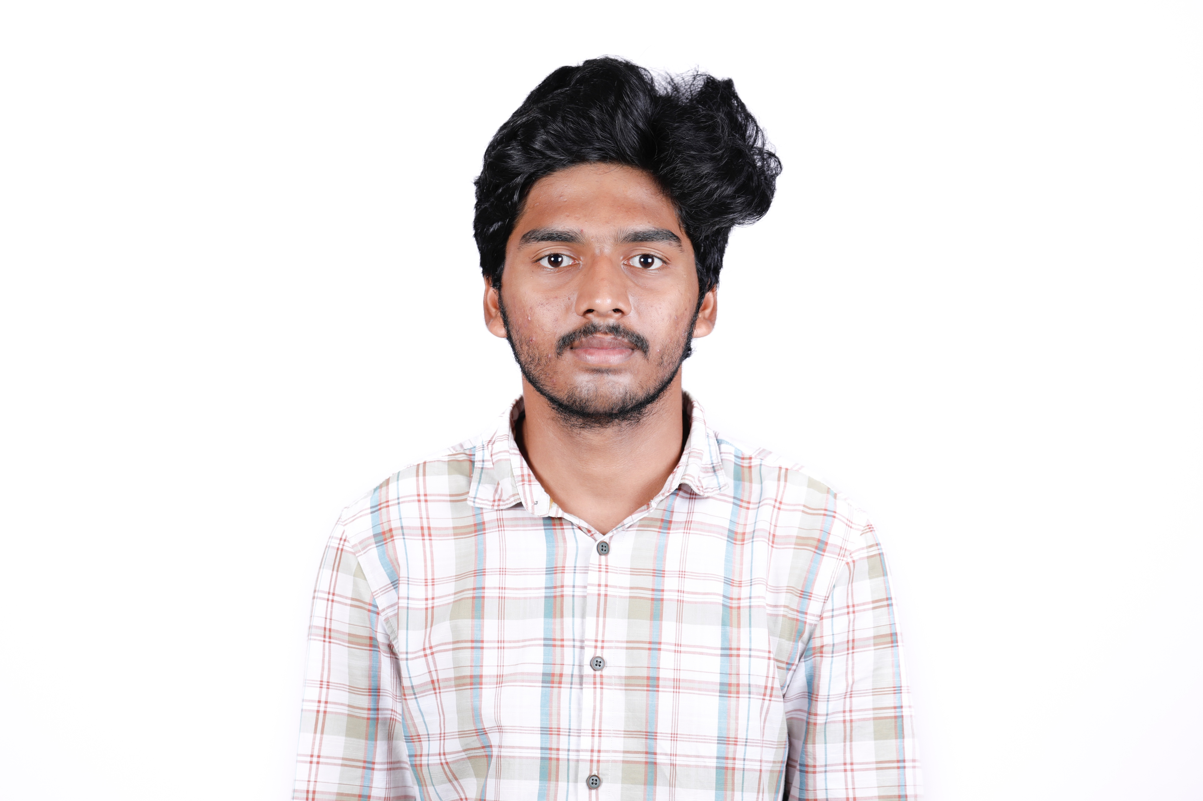
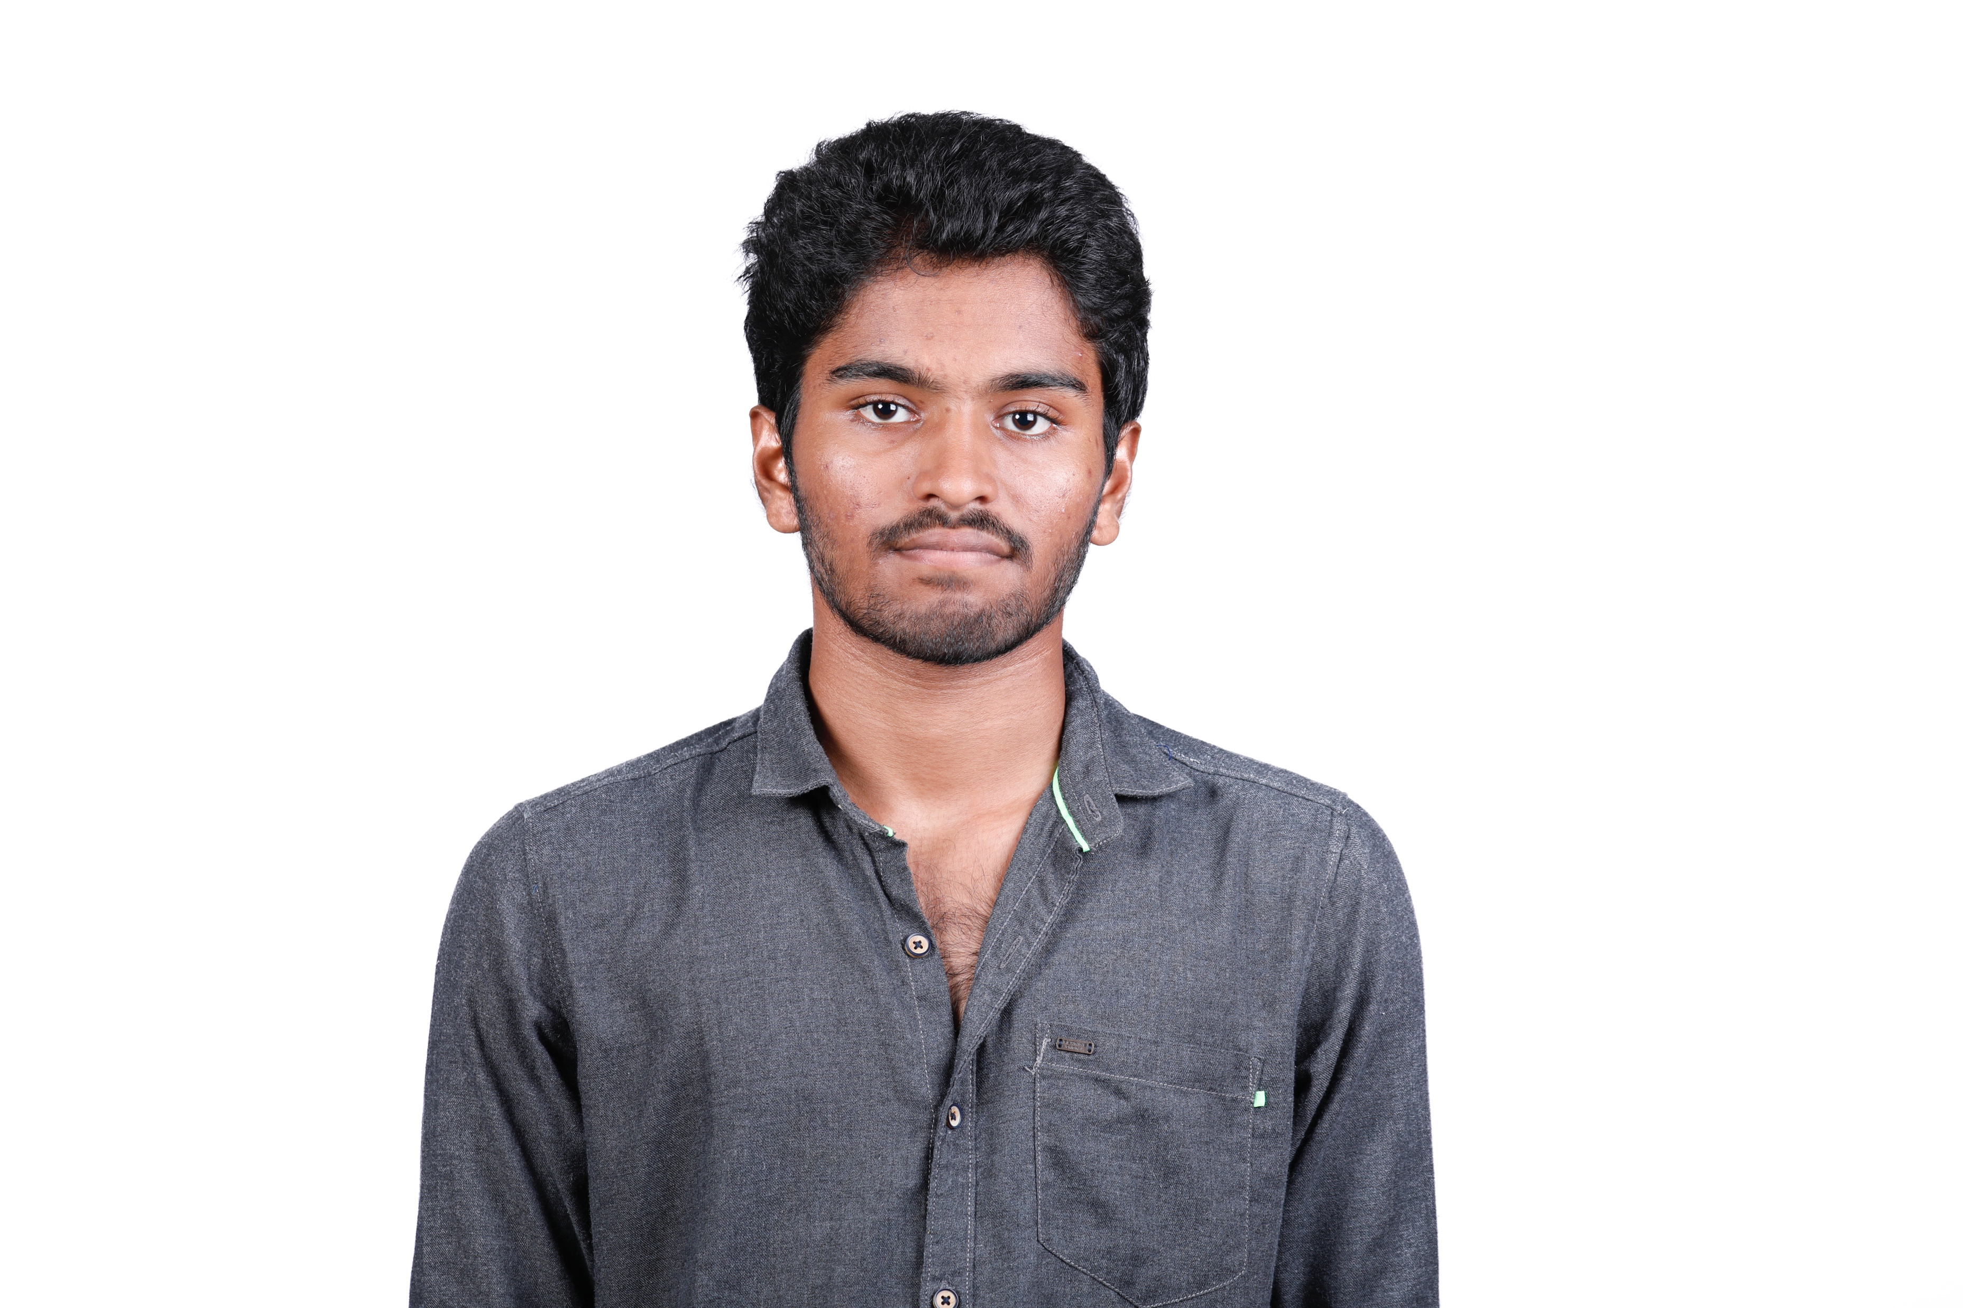
NEERAJ
HELLO
Team Lead
OUR TEAM

Slide 3
SUMANTH
HELLO
Developer
OUR TEAM

Slide 4
UDAY
HELLO
Community
Coordinator
OUR TEAM

Slide 5
VISWAKSENA
HELLO
Designer
OUR TEAM

Slide 6

SUSHANTH
HELLO
Social Media
OUR TEAM

Slide 7
INDRA KIRAN
HELLO
Campaign Manager
OUR TEAM

Slide 8
AYYAPA SWAMY
HELLO
Community
Coordinater
OUR TEAM

Slide 9

Building Future Innovators: The Success Story of Amrita Blockchain Club
Launched Amrita Blockchain Club, recruited strategically, developed courses, forged partnerships, guided students, and provided practical exposure.
110 Applicants
25 Recruited
3 Different Domains
WEB3
BLOCKCHAIN
AI

Slide 10
EDUCATIONAL GAP
ETHEREUM - CENTRIC FOCUS
PROBLEM
STATEMENT
LACK OF GUIDANCE
PRACTICAL EXPERIENCE
EXPOSURE
MENTORSHIP
HANDS ON PROJECT
SKILL DEVELOPMENT

Slide 11
OBJECTIVES
The Plan
Industry Collaboration
Diverse Tech Exposure
Collaborating with industry experts and other clubs for real-world application.
Expose students to a broad spectrum of blockchain technologies
Community Forge
Club Enhancement
Cultivate a dynamic student community committed to real-world impact, encouraging collaboration and knowledge exchange.
Strengthen and expand the existing Blockchain Club at Amrita Vishwa Vidyapeetham.
Hands-0n-Projects
Inspire active participation in hands-on projects, bridging theory and practical application.
Learning Program Establishment
Establish a robust and interactive learning program for practical exposure within the blockchain field.

Slide 12
ACTIVITIES

Slide 13




Establishment
For Enhanced seamless interactions, overcoming challenges
Discord
Creation
Efficiency
Serving a valuable tool for course documentation
Online
activities
Buzzed as the educational hive.

Slide 14
Twitter
LinkedIn
456
897
Instagram
Whatsapp
568
456
Social
Effective Social Media and Direct Communication Management
Media
Overseeing all social media platforms, including LinkedIn and Instagram, we actively manage emails, responding promptly to student inquiries. Engagement with students on WhatsApp and Discord is maintained to ensure effective communication and interaction.

Slide 15



Online Sessions
Conducted engaging AI sessions with insightful discussions on Blockchain and Web3 technologies.
Platforms for students to explore intricacies of AI, blockchain advancements, and the decentralized web.
Interactive talks provided valuable insights, fostering a deeper understanding of cutting-edge technologies.

Slide 16


Company Collaboration and Networking
New Tech
Industry Collaboration
Click Here
Click Here
Functions
Web3 Community
Applications
AI Integration
Kerala Blockchain Club

Slide 17
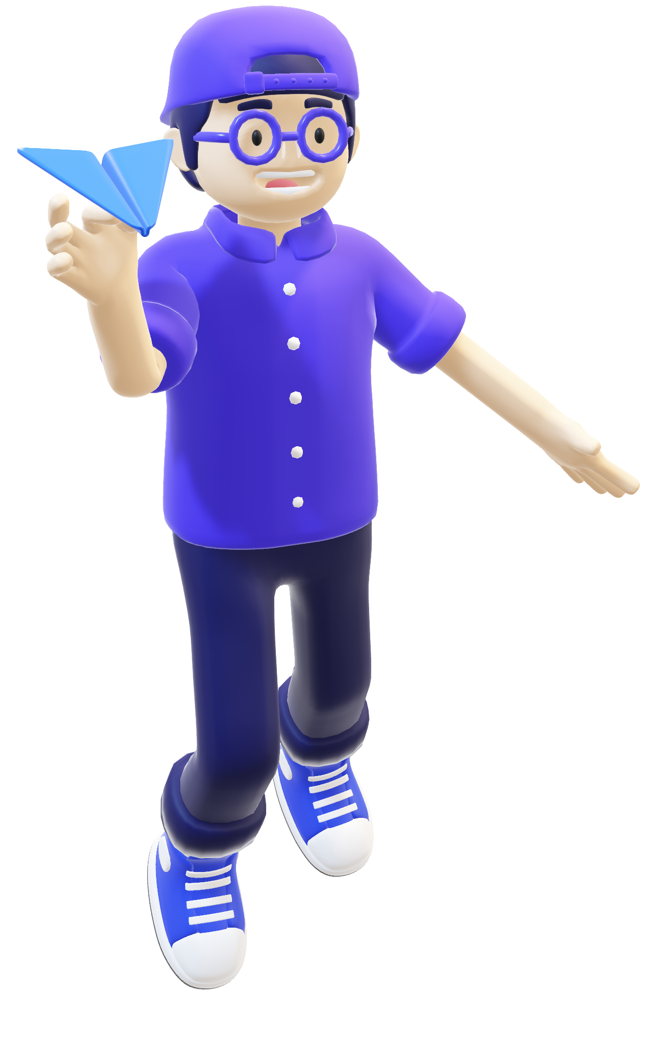

Mentor Interaction
Teacher mentor collaboration
1st Term
We actively sought feedback from mentors Sai Shibu Sir and Jinesh Sir, incorporating insights and guidance, and further enriched our approach with educator Deepthi Mam's input.
2nd Term
External Outreach and Guidance:
We engaged external individuals for diverse ideas and received guidance from clubs like Bi0s, AMFoss, and ACM, crucially shaping our club's direction.

Slide 18

Student
Awareness
Addressing hesitation in exploring beyond web and app development, we raised awareness about blockchain for 1st and 2nd-year students, emphasizing its potential and impact.

Slide 19




Efficient Student Management
Student Management.
Task Execution
Positive environment
110 responses
60 student interview
23 finalized students

Slide 20
Core Blockchain
Web3
Virtual session
Panel discussions
Collaborative projects
Blogs
Tech blog analysis
Live demonstrations
Learning Modules
Practical assignments
Course
Preparation
Artificial Intelligence
Online lectures
Research papers
Coding challenges
Continuous feedback loops
Lets Get’s Started

Slide 21
Transition in faculty Mentorship
01
02
Lab Allocation Challenge
Sai Shibu Sir’s departure prompted a transition; Jinesh Sir guides seamlessy.
Overcome Challenges
Obtaining WNA lab faced challenges; dicussions led to first-floor alternatives
Efficient Recruitment Amidst Midterm Exams
Semester Timing Constraints Mitigation
04
03
Evaluate the sem schedules for s1, s3 and s5 batches to identify common time slots for sessions and workshop
Managed exams and recruitment, selected 23 from 110 applicants effectively.

Slide 22
Recruitment
Subtitle text here
60%
40%
1ST YEARS
2ND YEARS
Web3/
Dapp
Blockchain
Artificial
Intelligence
Web3/ Dapp
Blockchain
Artificial Intelligence

Slide 23


Expansion
Innovation
Competitions
Collaboration
Skill-building
Advancements
Research
Cross
disciplinary
Future Scope

Slide 24
Step By Step Strategy
04
03
02
01
Project Based Learning Initiatives
Enhanced Mentorship Program
Community Engagement and Networking
Strategic Curriculum Expansion

Slide 25

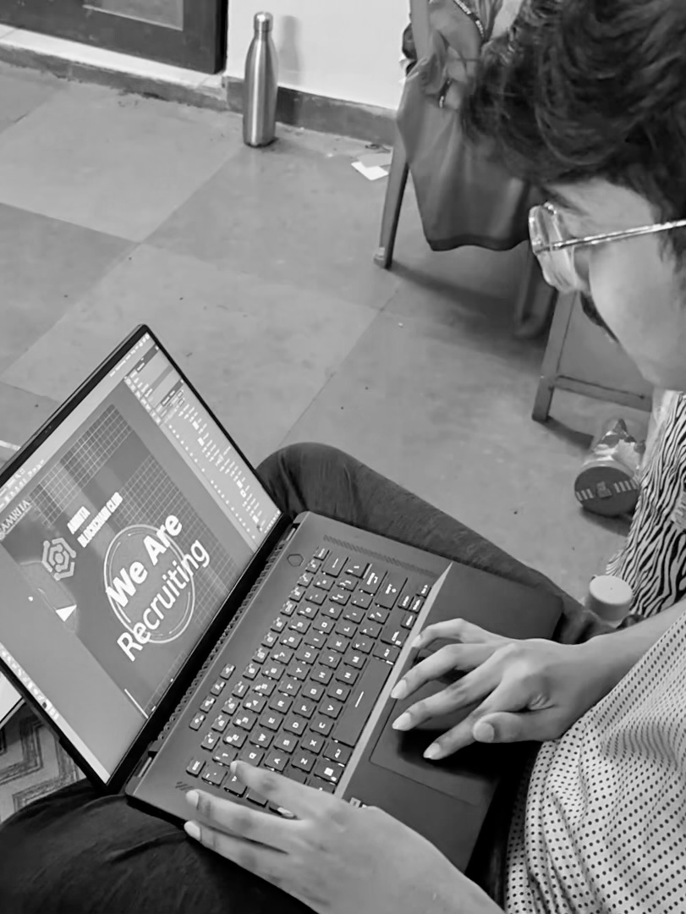
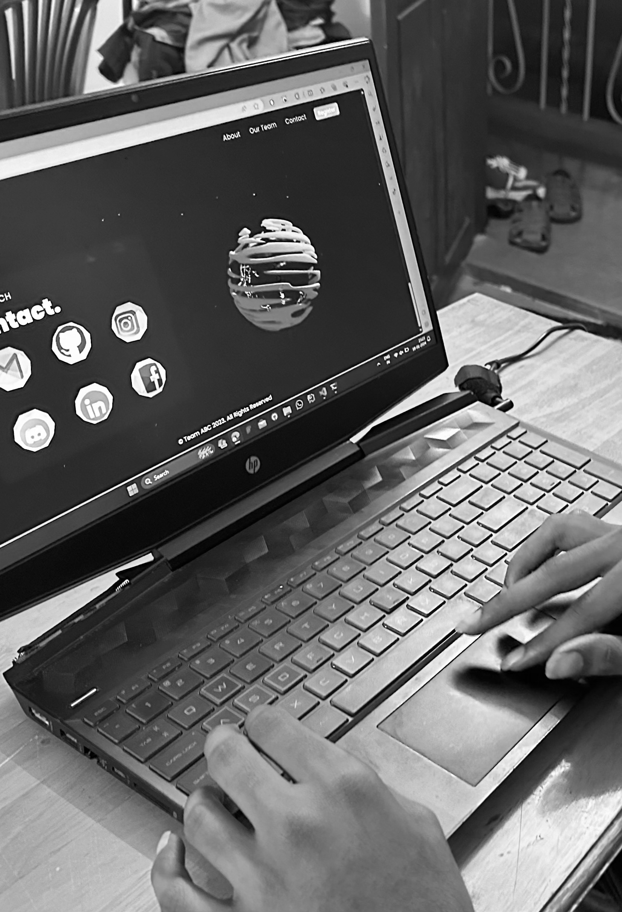
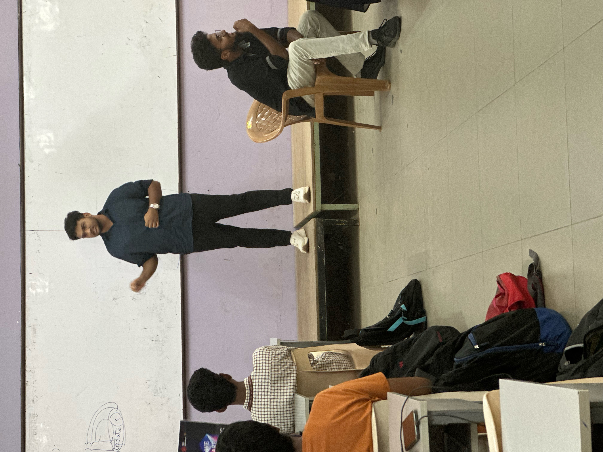
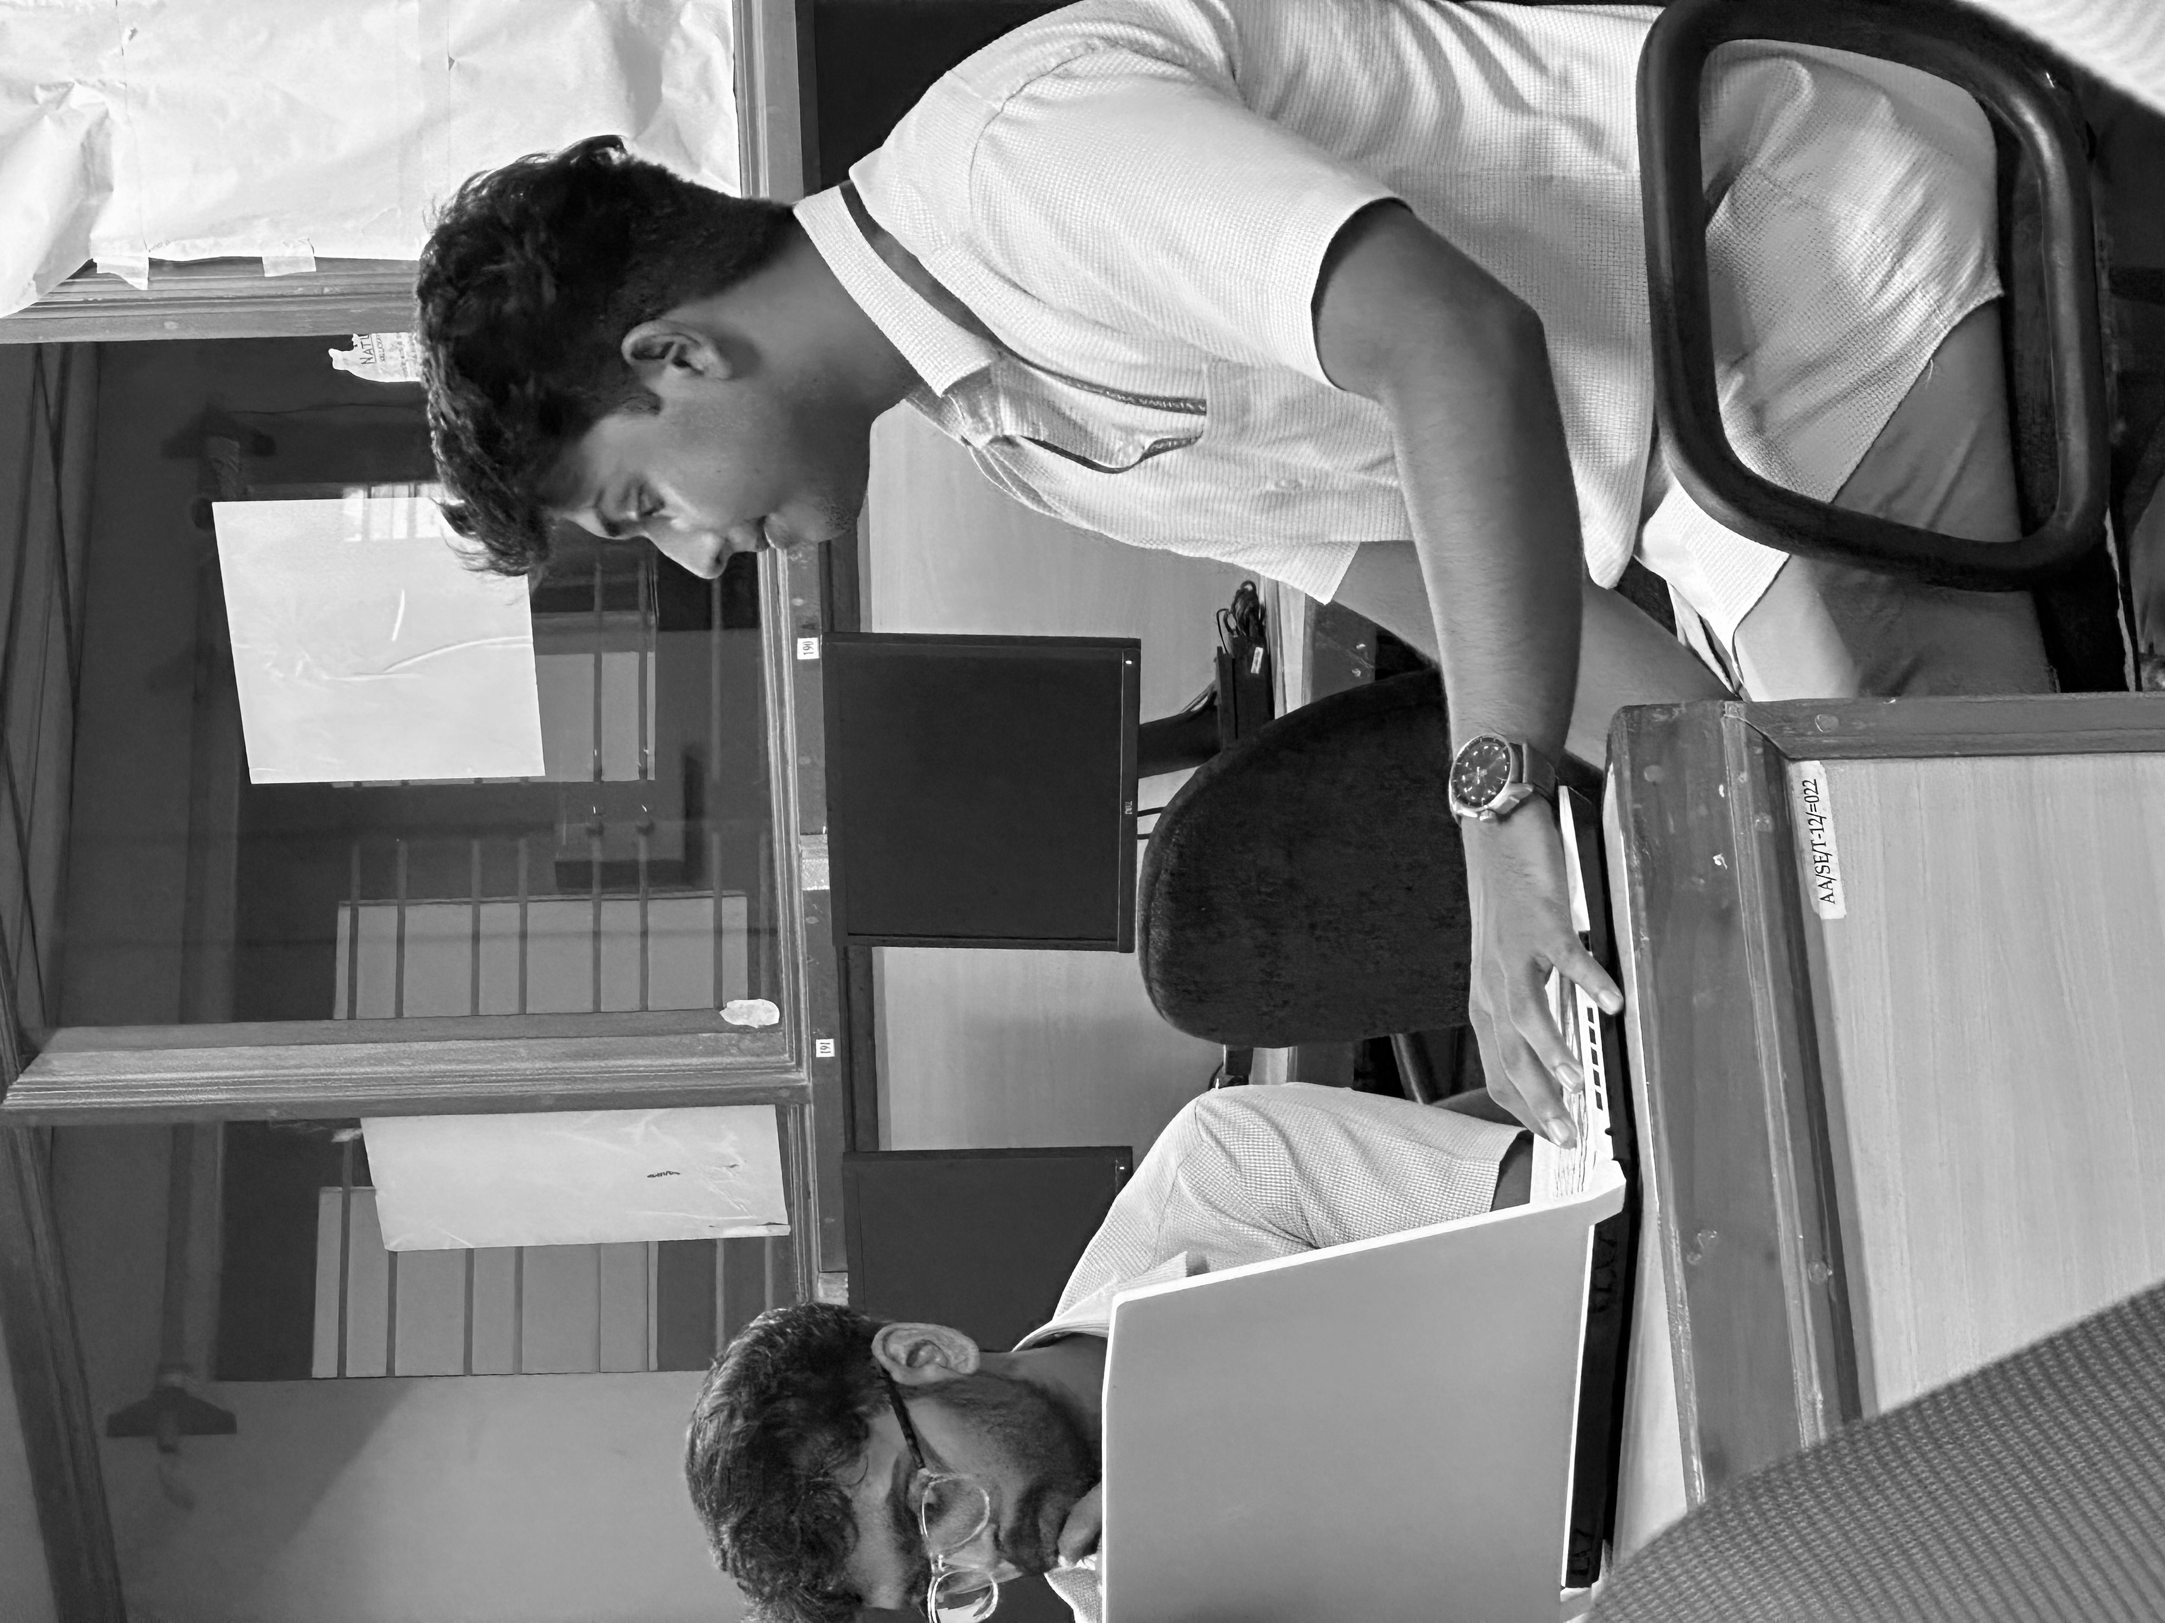
IMAGE GALLERY
Campaign

Slide 26
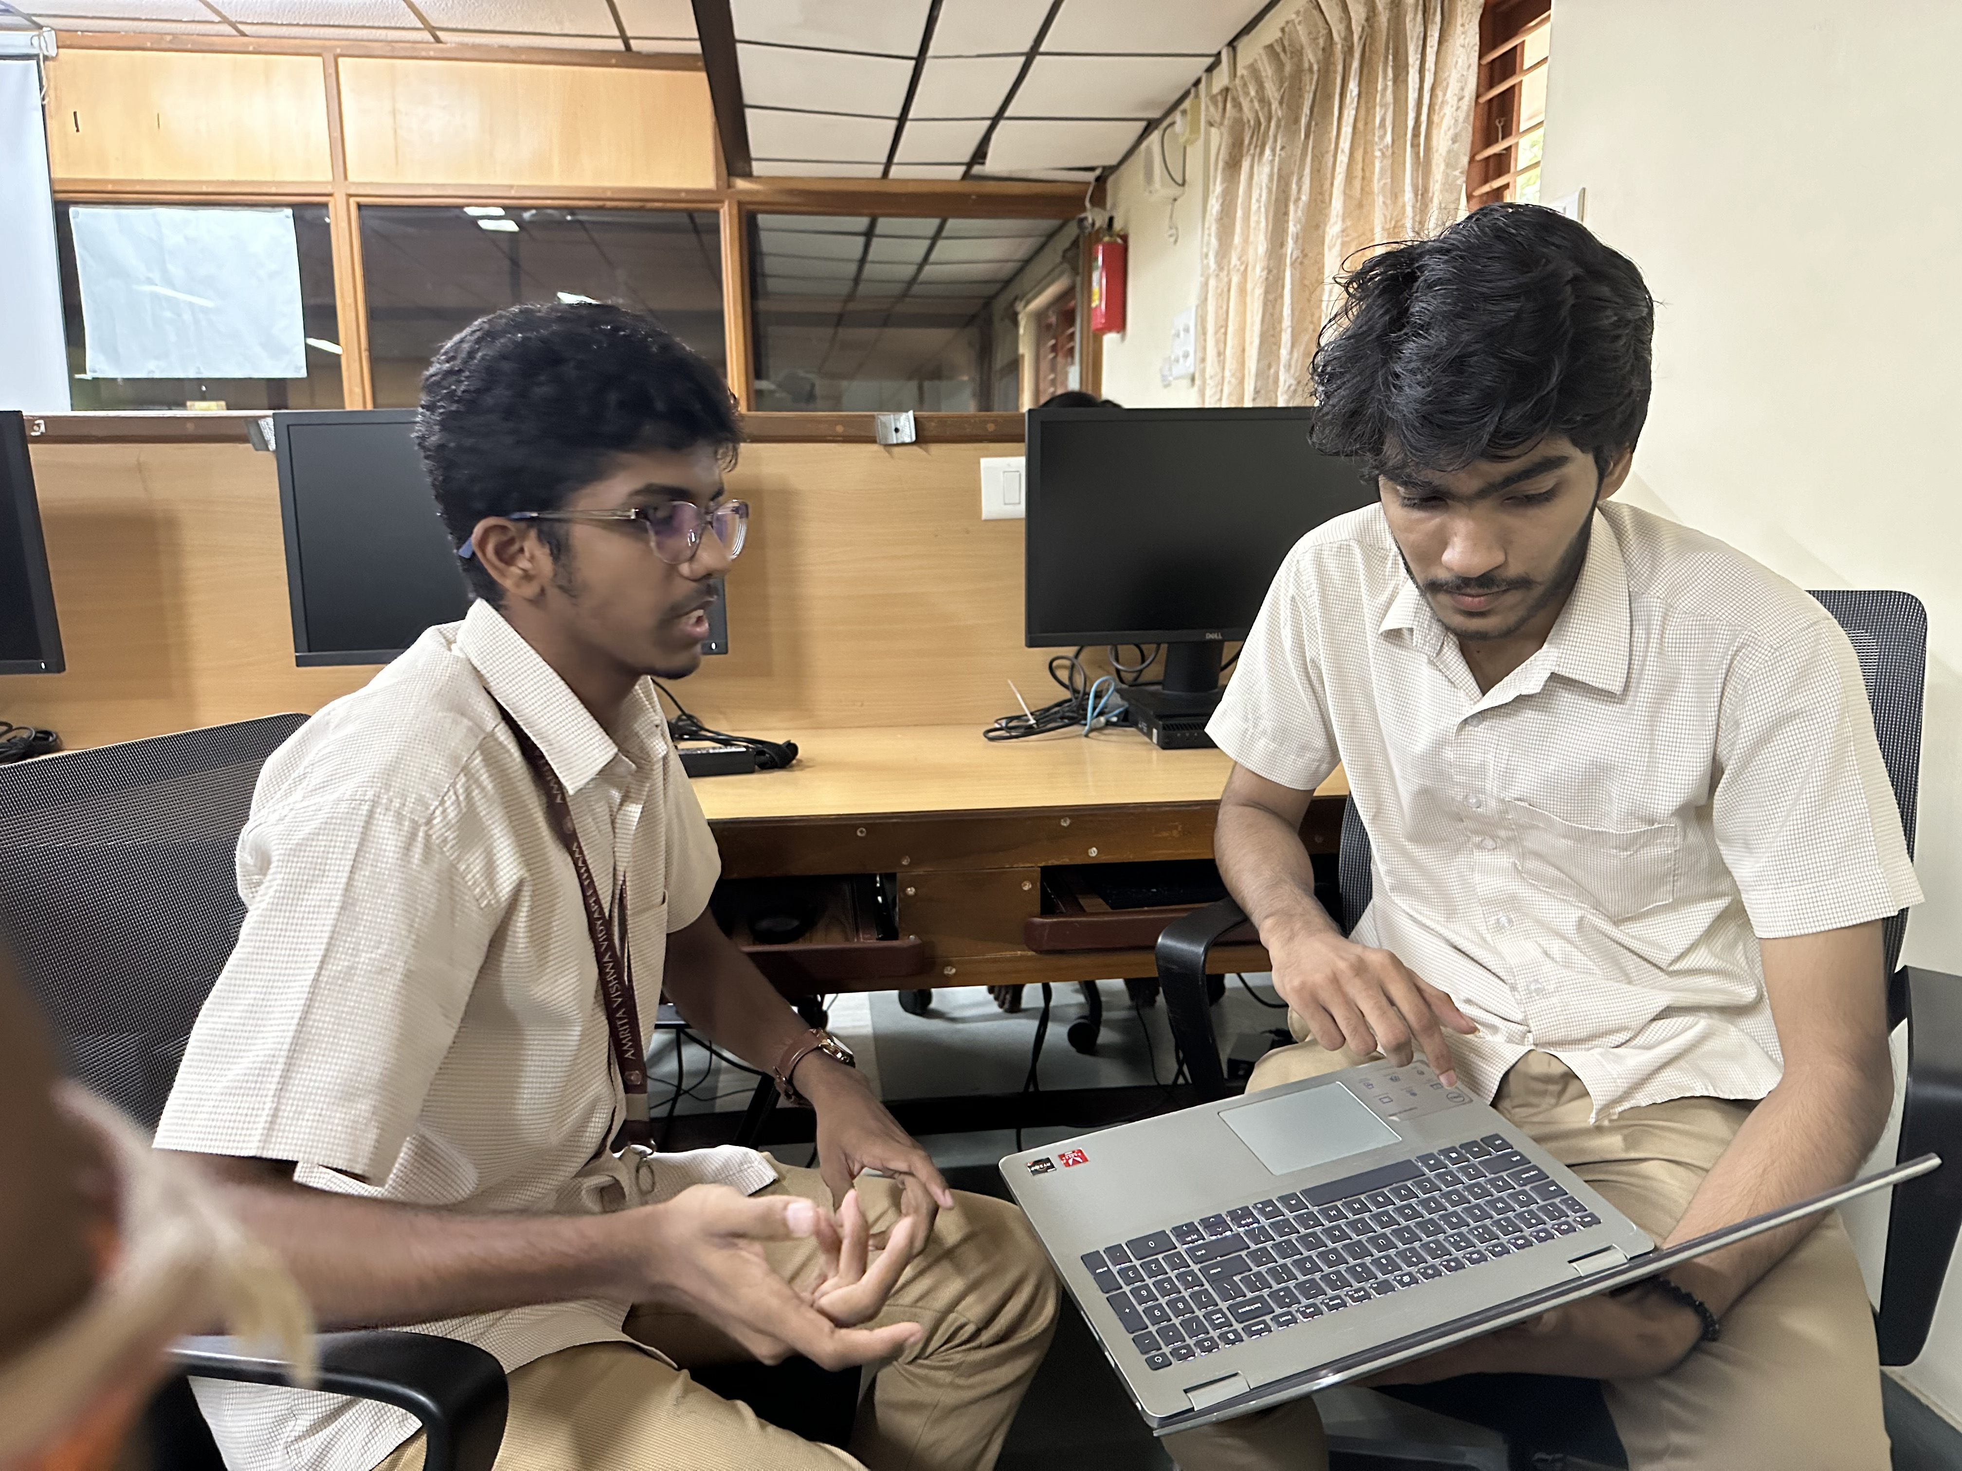
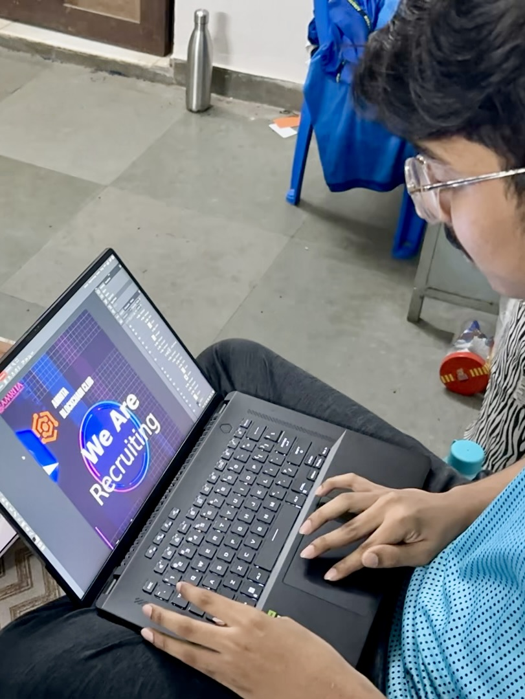
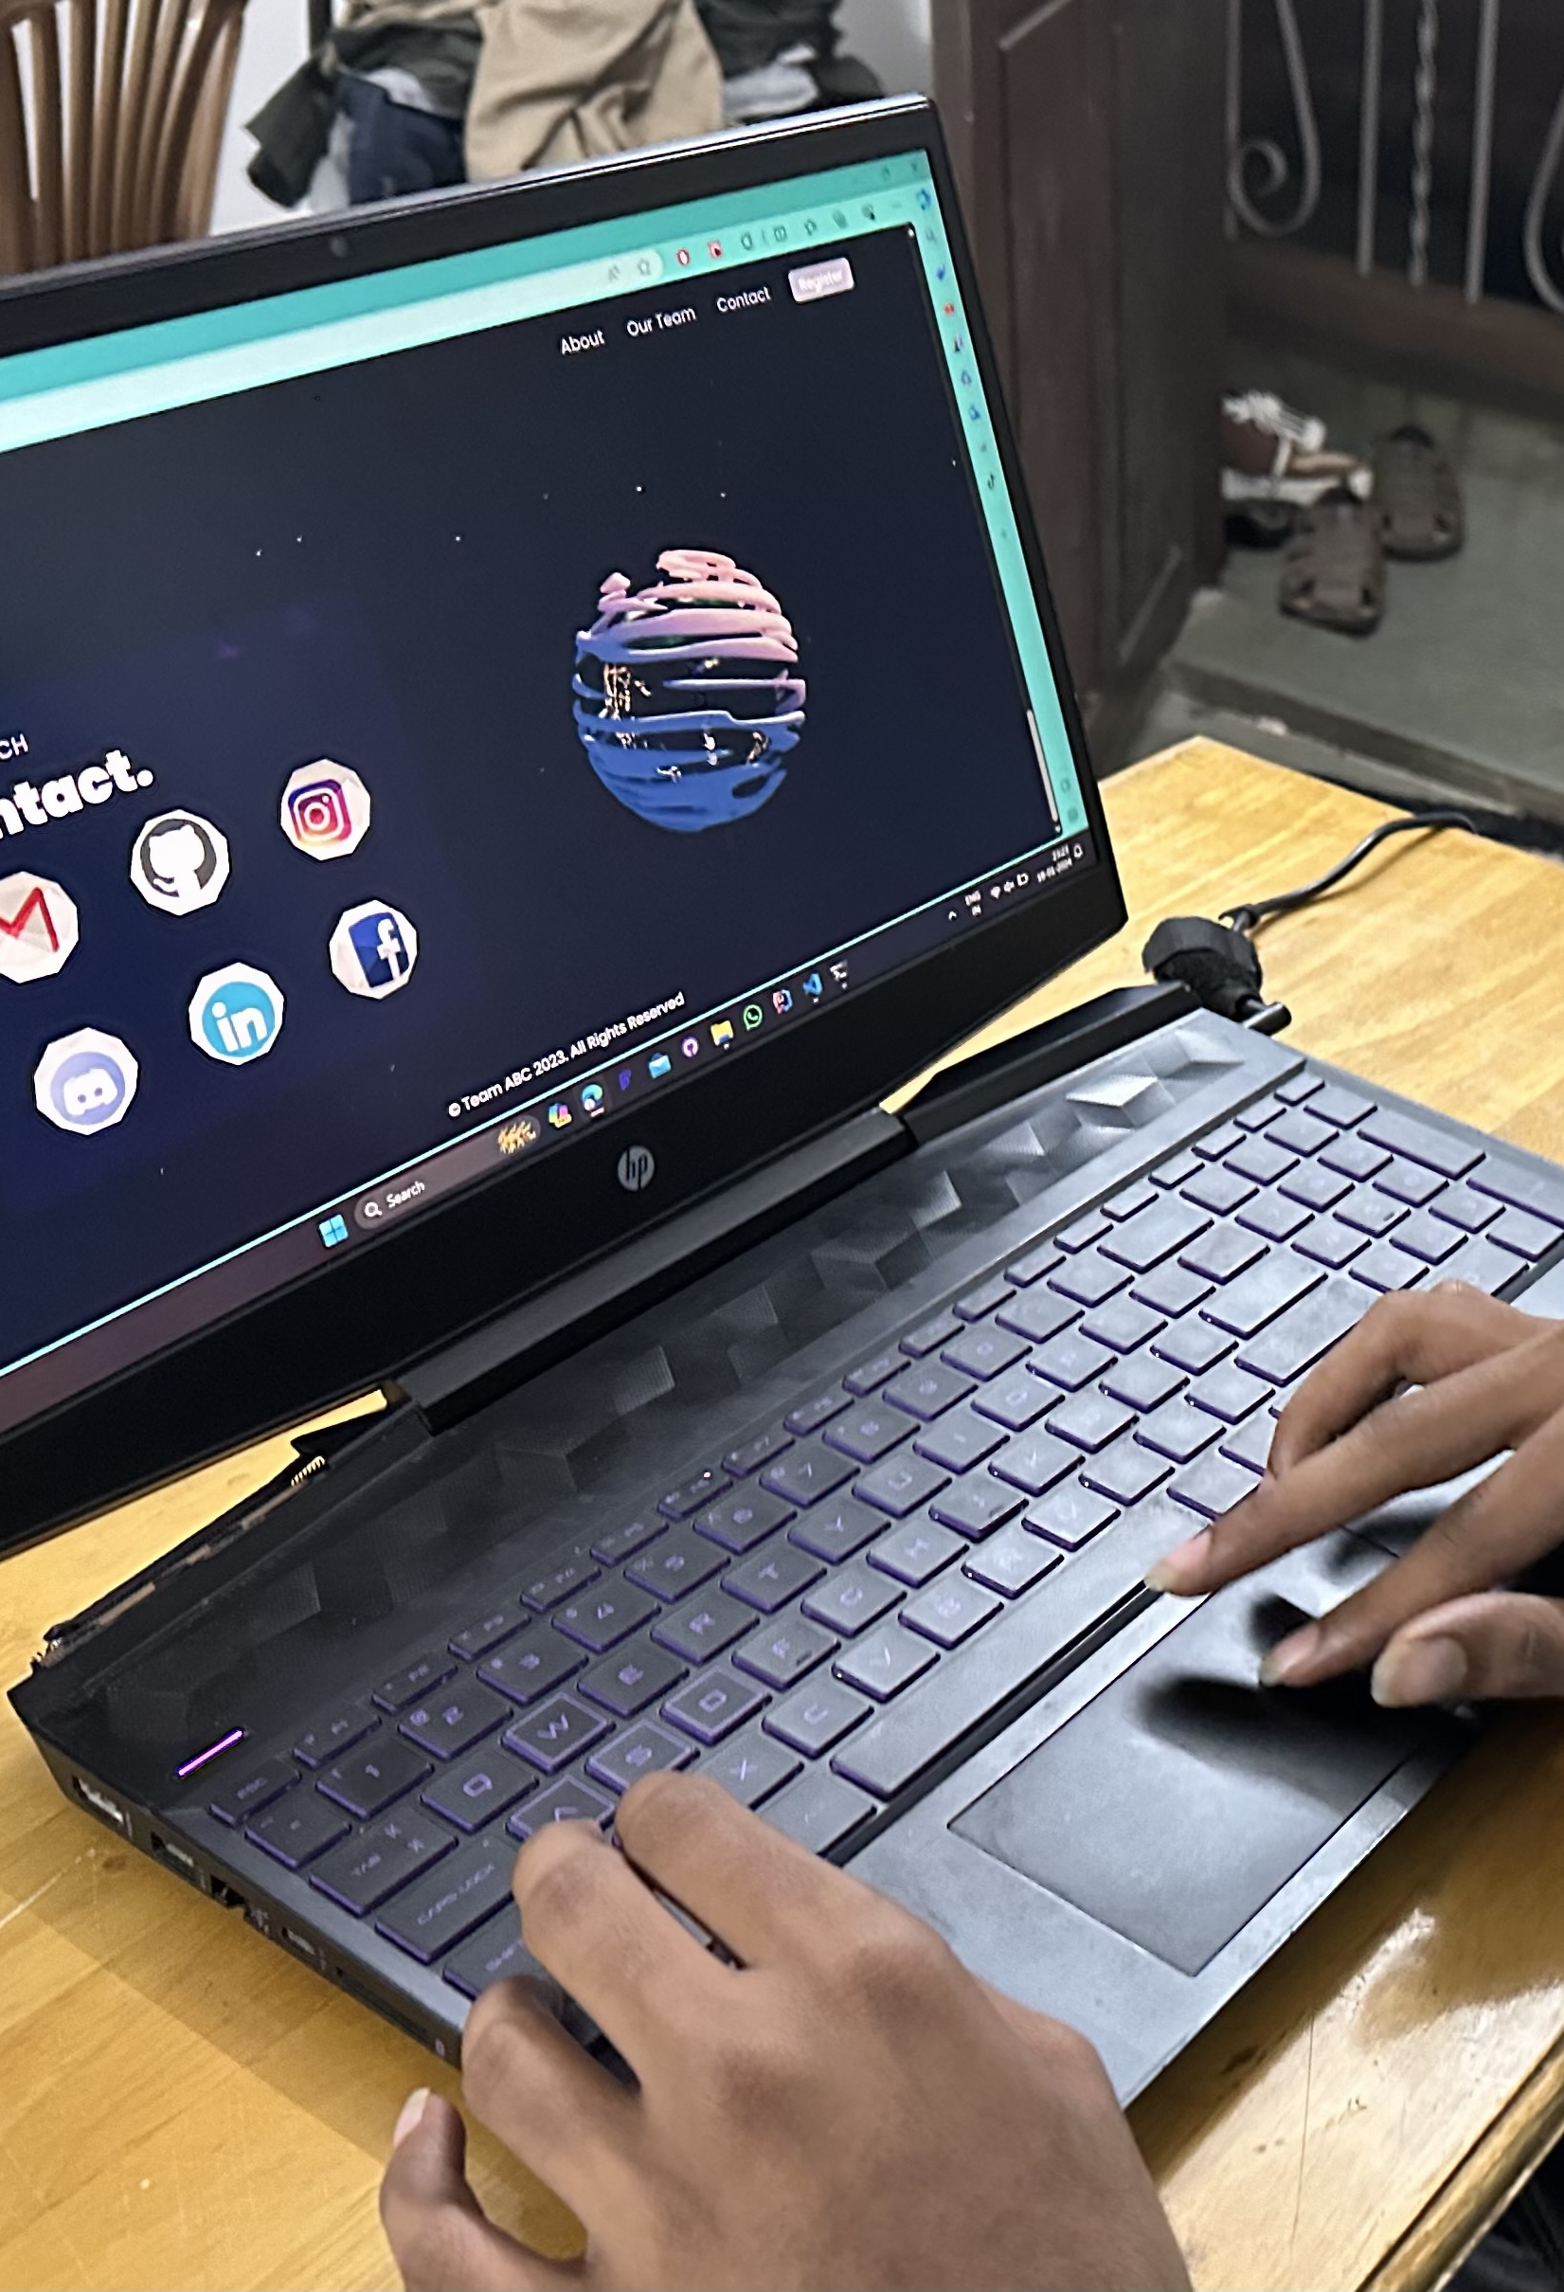
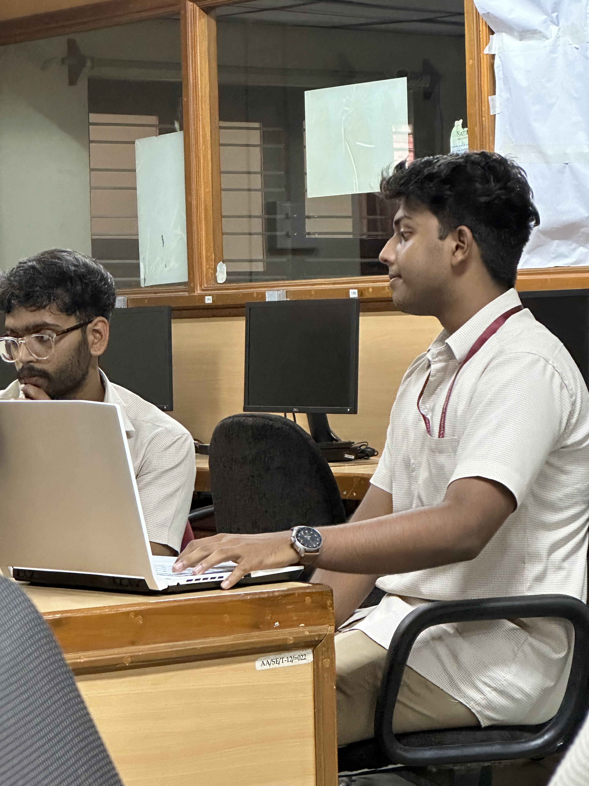
IMAGE GALLERY
Recruitment

Slide 27
IMAGE GALLERY
Solo Session

Slide 28
IMAGE GALLERY
Poster design

Slide 29
IMAGE GALLERY
Website Making

Slide 30
Sincere thanks to Vice Chair Mam, Geetha Mam, SSR Program, Darshana Mam, Sai Shibu Sir, Jinesh Sir, CIR department and contributors. Grateful for Success.

